Slide 1

California Hospital Performance Comparison
Data Visualization Track
Presented by Jenae Journot, Manuel Sosa and Greg Thomas

Slide 2
Project Background
PURPOSE: For this project, our goal was to build an insightful dashboard including key data visualizations that hospital administrators in California could utilize when making operating decisions.
KEY OBJECTIVE: By analyzing and visualizing the revenue mix and types of care provided at each hospital, the user can uncover trends and insights about the current healthcare system operations in California.
We also analyzed data from both the ten largest and smallest hospitals – based on the size of their total assets – to provide a benchmark for comparison.

Slide 3
3 Questions to Answer via Visualizations:
Where are the ten largest and ten smallest hospitals and healthcare systems located?
What is the mix of patient revenue by payer category?
What is the breakdown of type of care?

Slide 4



Dataset
9 Payer Categories
431 Hospitals
$16.5B in Combined Net Revenue
Our dataset comprises of 431 records focusing on California hospitals and health systems’ financial and operational data, reported in 2022. We primarily focused on the following information:
1. Location
2. Asset size
3. Revenue by payer type
4. Type of care
Data Source:
Hospital Annual Financial Data - State of California, Department of Health Care Access and Information, 2022.
6 Types of Care
108 Hospitals located in L.A. County
$248.5B in Combined Total Assets

Slide 5






Tech Stack
JavaScript: Interactive web pages
Pandas: Data analysis for Python
Plotly: Interactive online graphing library
Node.js: Web development
Leaflet: Interactive maps
PostgreSQL: Database system
GitHub: Collaborative coding platform

Slide 6
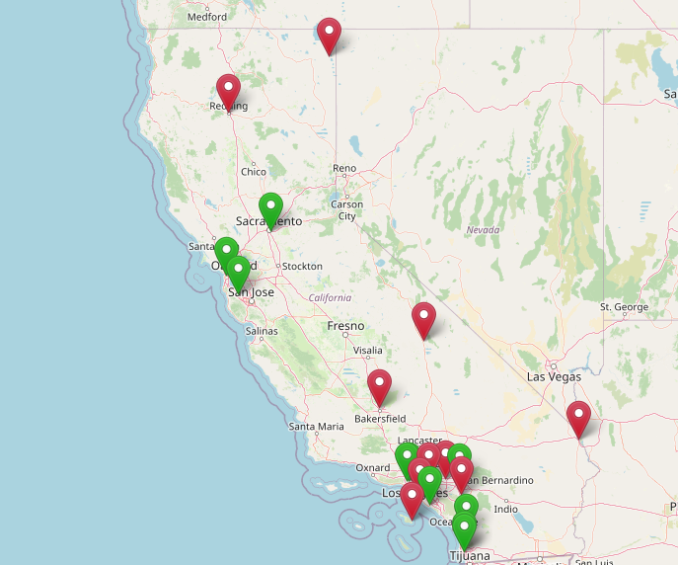
Largest and Smallest Hospitals
The size of the hospital was determined by comparing total assets.
Larger hospitals are teaching or corporate and located in metro areas.
Smaller hospitals are rural or concentrate on a specialty.
Green = Ten Largest
Red = Ten Smallest

Slide 7
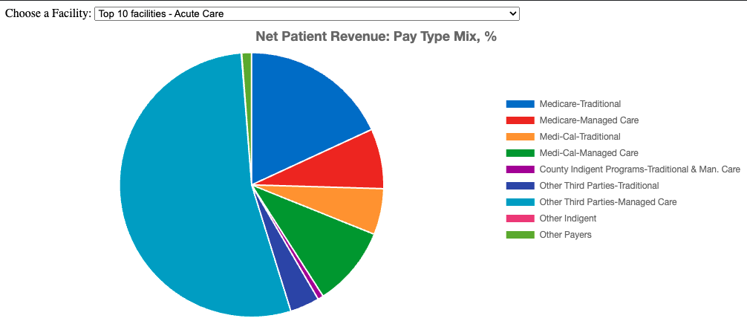
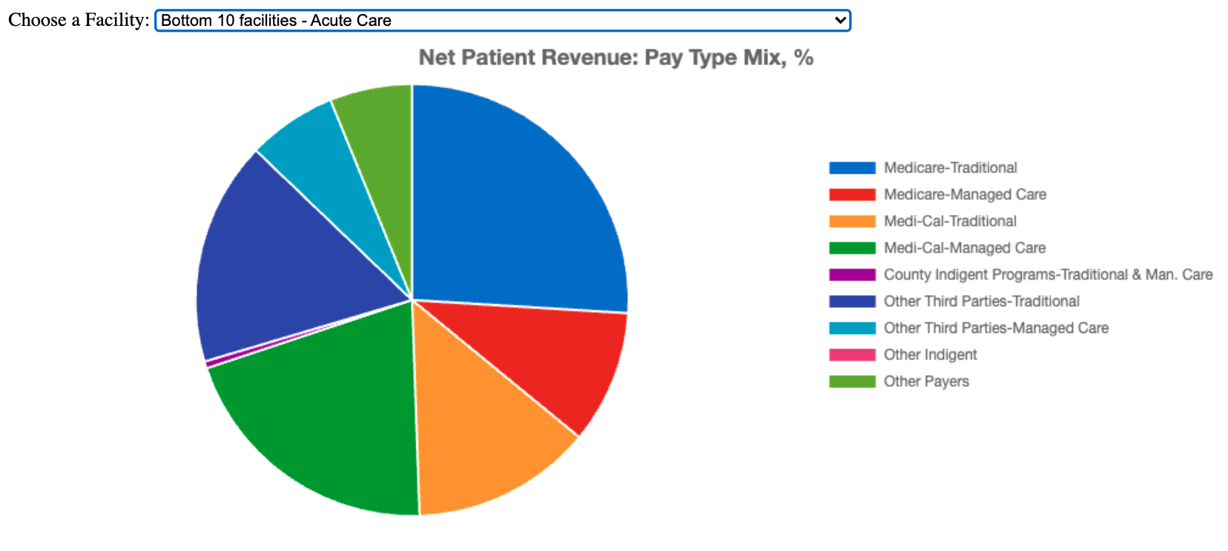
Top 10 Facilities – Acute Care Medicare Trad – 18.12% Medicare MC – 7.34% Medi Cal Trad – 5.63% Medi Cal MC – 9.81% County Indigent – 0.70% Third Part Trad – 3.60% Third Part MC – 53.54% Other Indigent – 0.06% Other – 1.20% Bottom 10 Facilities – Acute Care Medicare Trad – 25.97% Medicare MC – 9.99% Medi Cal Trad – 13.49% Medi Cal MC – 20.43% County Indigent – 0.52% Third Part Trad – 16.78% Third Part MC – 6.66% Other Indigent – o.oo% Other – 6.16%

Slide 8
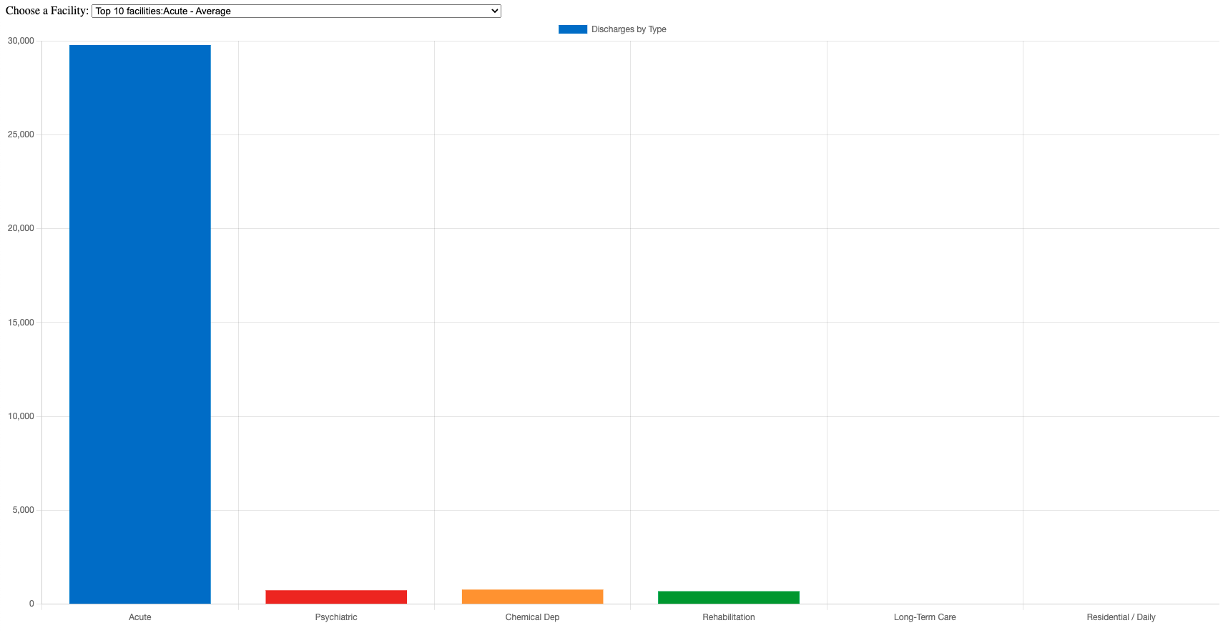
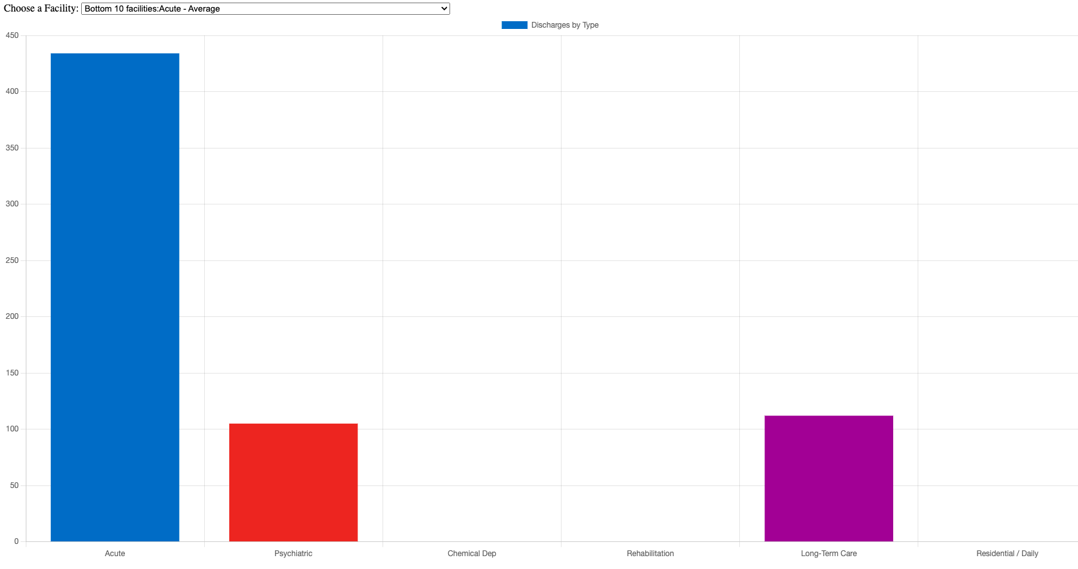
Top 10 Fac. Acute Discharges – Average by Type Acute 29,774 Psychiatric 737 Chemical Dependency 774 Rehabilitation 685 Long-Term Care -- Residential / Daily Care -- Bottom 10 Fac. Acute Discharges – Average by Type Acute 434 Psychiatric 105 Chemical Dependency -- Rehabilitation -- Long-Term Care 112 Residential / Daily Care --

Slide 9
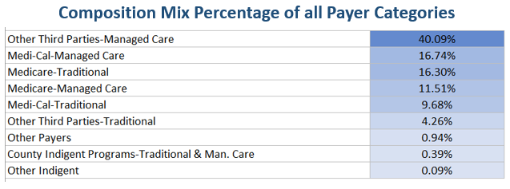
Net Patient Revenue by Payer Category:
The data suggests that 'Other Third Parties-Managed Care' (e.g., private insurance companies, employer-sponsored health plans, or other managed care organizations) is the largest category, accounting for just over 40.09% of the composition mix.
Importance of Payment Mix:
1. Revenue Optimization
2. Regulatory Compliance
3. Risk Management

Slide 10
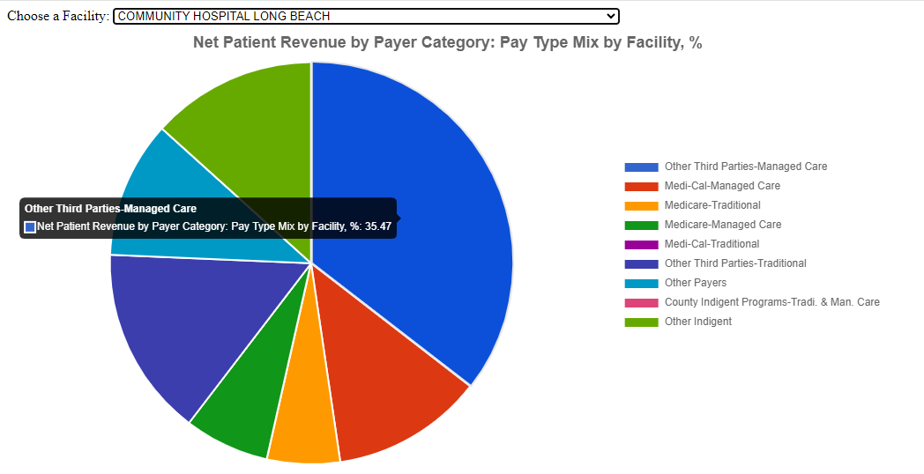
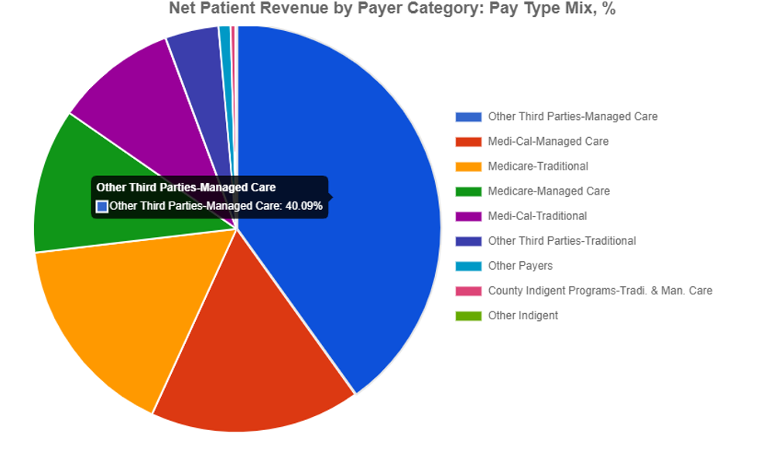
Net Patient Revenue by Payer Category

Slide 11
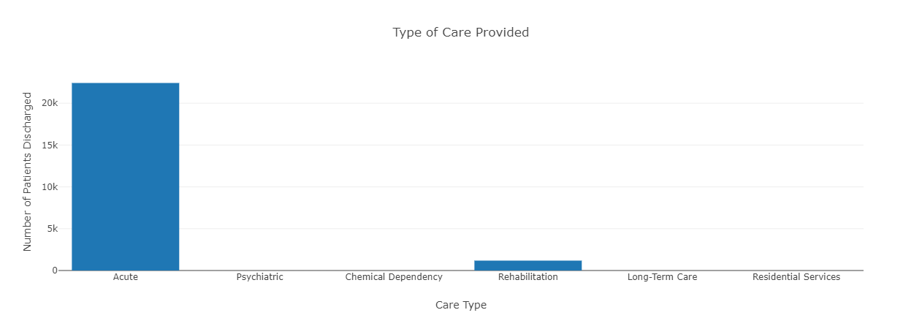
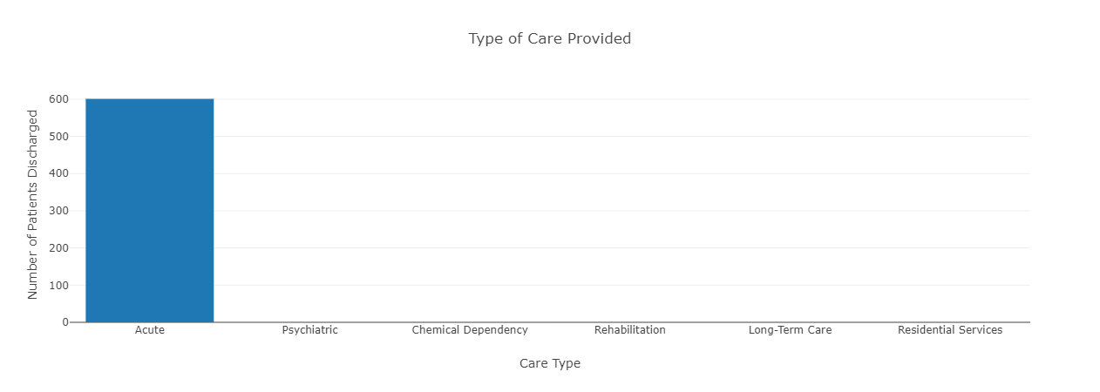
Type of Care
The type of care provided at each hospital varied. For most hospitals, the majority of care provided fell under Acute Care – which includes services like medical/surgical acute, obstetrics acute, definitive observation, medical/surgical intensive care, and coronary care.

Slide 12
Data Limitations
Lack of Comparative Data by years:
The data represents one specific year, 2022. Without time-based data, it's challenging to discern trends, assess progress, or make year-over-year comparisons.
Potential for Misinterpretation:
The charts do not provide understanding on the underlying factors, such as policy changes or patient demographics, that could affect both net revenue and total asset size.

Slide 13
Challenges and Learnings
Extracting the data from database and importing it into JavaScript
Limited Admin access to install and reinstall applications

Slide 14

Any Questions?

